Slide 1
1300: Pennsylvania Risk Assessment: A Closer Look at the Factors and Summary: Booster Shot

Slide 2
Competency
204-3: The child welfare professional knows how to use the risk assessment instrument.

Slide 3
Learning Objectives
Create an understanding of risk assessment
Assist participants in making less subjective judgments about their families and the risks to their children
Understand how to relate 15 risk factors to the allegations and information received during an investigation or during ongoing services
Analyze the dynamics of a family by using the risk factors to document the importance of how the risk levels assigned relate to the safety of a child
Understand how the interaction of factors impacts the level of risk
Demonstrate the ability to write an effective summary
Understand how to analyze the dynamics of a family and document their ratings on the matrix
Write an effective risk summary

Slide 4
Agenda
Introduction
Clarification and Classification of Risk Factors
Overall Severity and Overall Risk
Techniques for Insuring Risk Assessment Ratings are Supported by the Summary
Writing Assessment Summaries
Closing

Slide 5
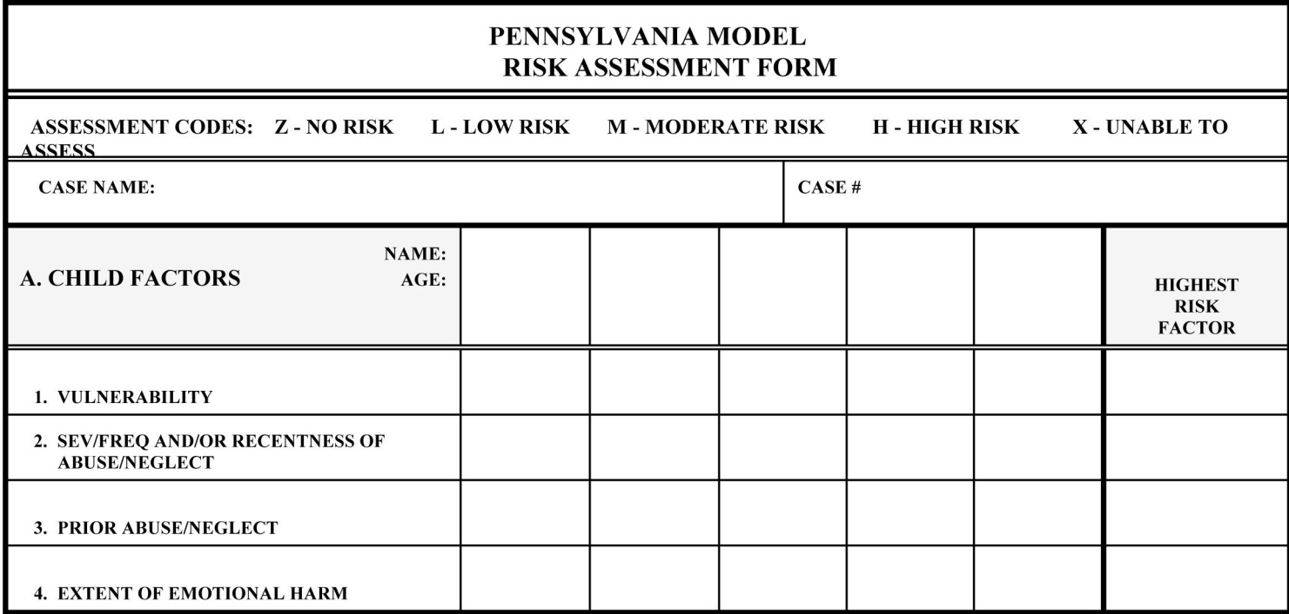
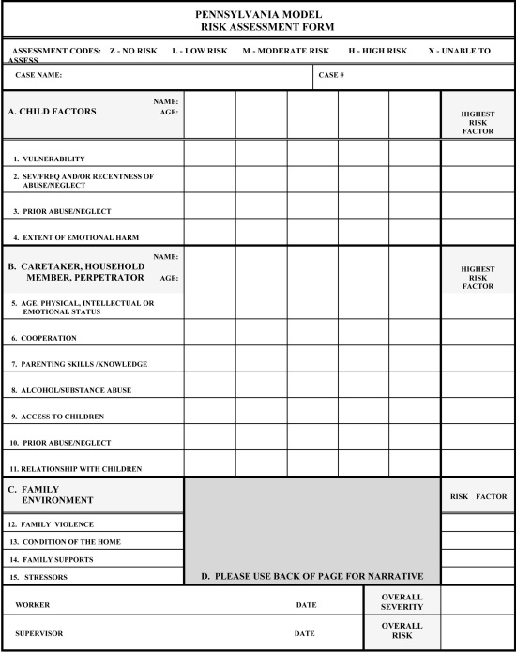
Pennsylvania Model Risk Assessment Form

Slide 6
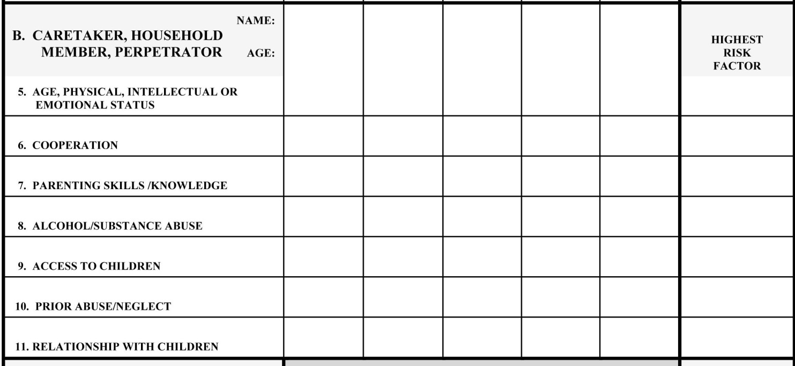
Pennsylvania Model Risk Assessment Form, Cont’d

Slide 7
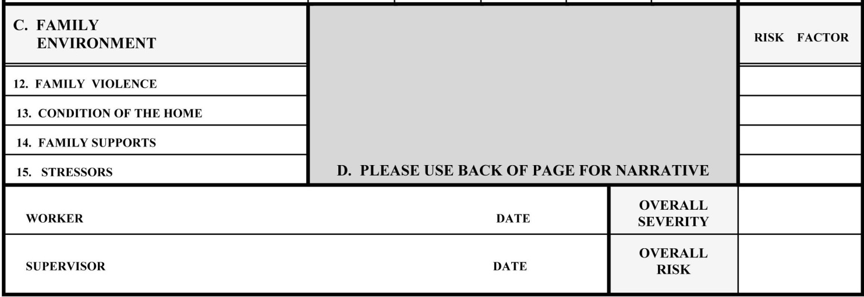
Pennsylvania Model Risk Assessment Form, Cont’d

Slide 8
Risk Assessment Summary Checklist
Have you explained the overall risk level, why you rated it the level you did, and provided specific facts or rationale for your decision?
Have you explained the overall severity level, why you rated it the level you did, and provided specific facts or rationale for your decision?
Have you explained the reasons for all of the X ratings you chose on the assessment?
Have you named all the household members and discussed their age and relationship to the identified child(ren)?

